Slide 1
27-3-25

Slide 2
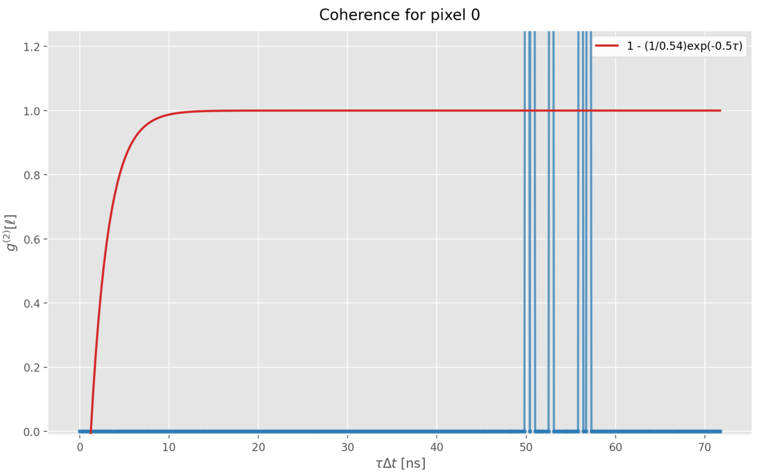
Last time: why no pixel autocoherence?

Slide 3
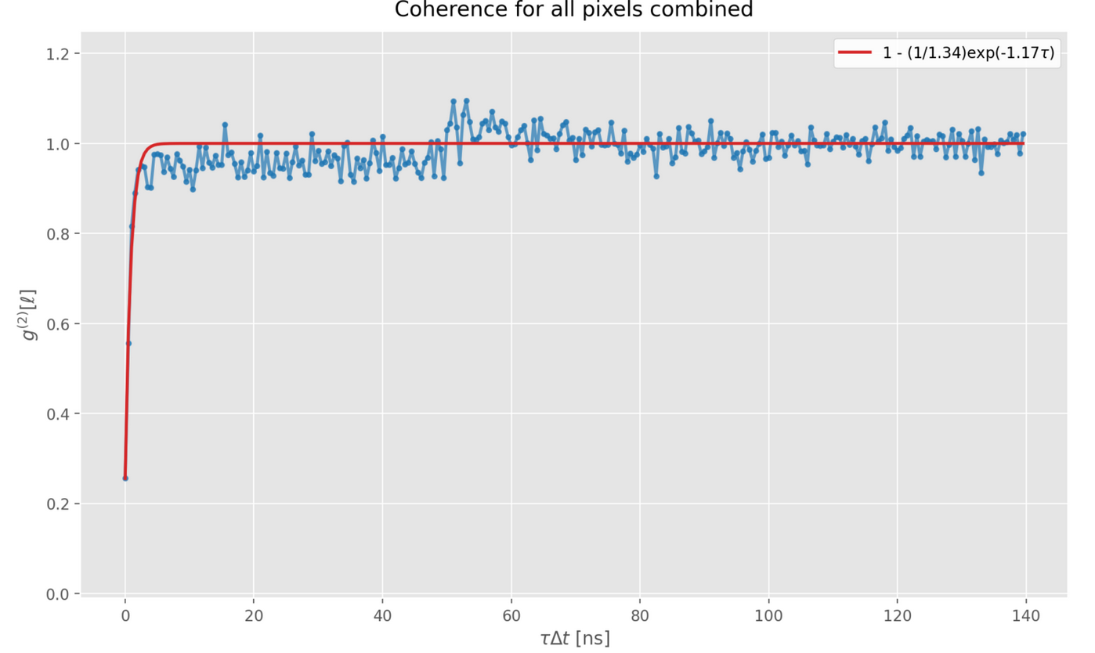
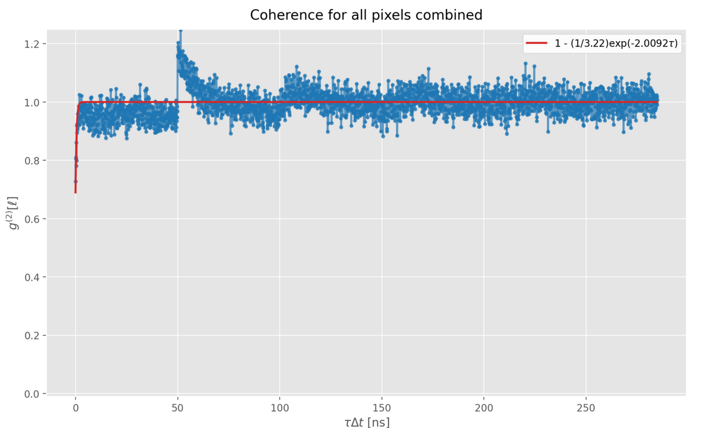
Dead time
To solve: create an updated statistical model and correct the expected bias.
Below: whole-detector autocoherence

Slide 4
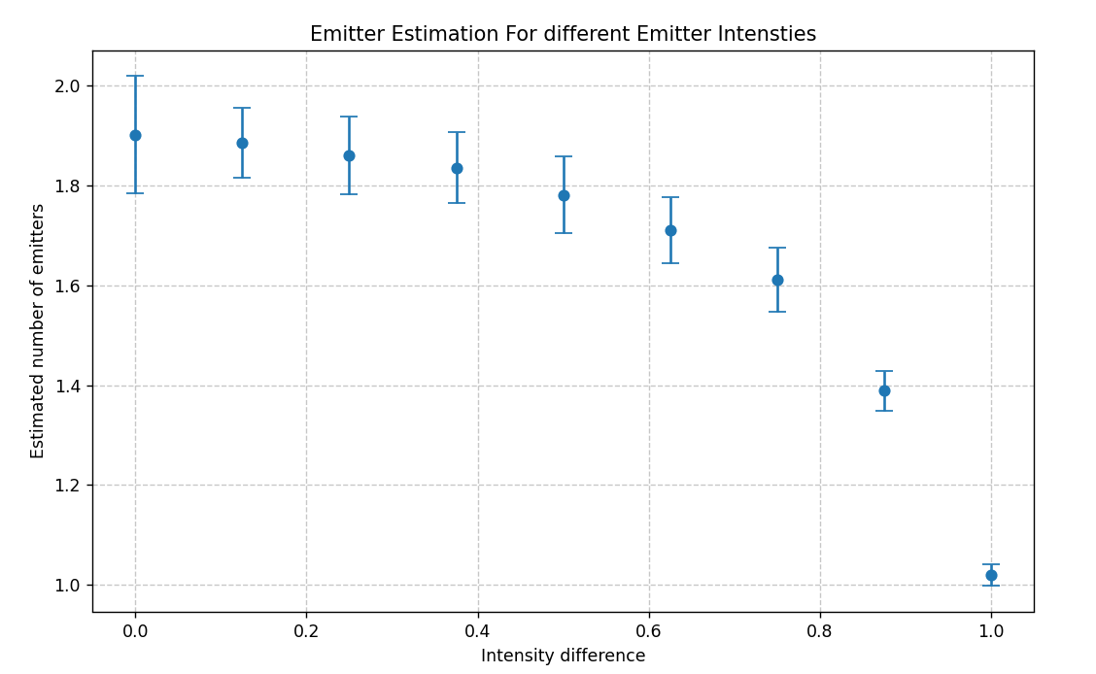
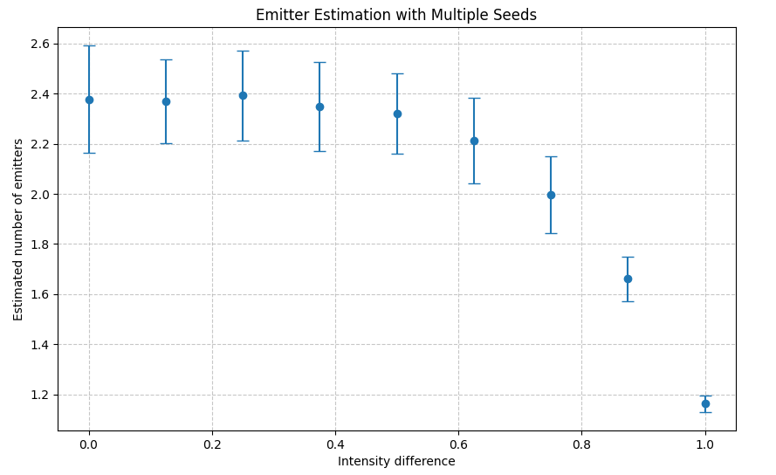
Emitter intensity
Varied laser intensity from 330kW/cm2 to 0 for the second or third emitter.
All in center spot
Relatively insensitive to this: can have more than 50% difference in emitter intensity and still detect, provided absolute intensity is large enough. Here, left with variable optimized k, right with fixed k=2.0092

Slide 5
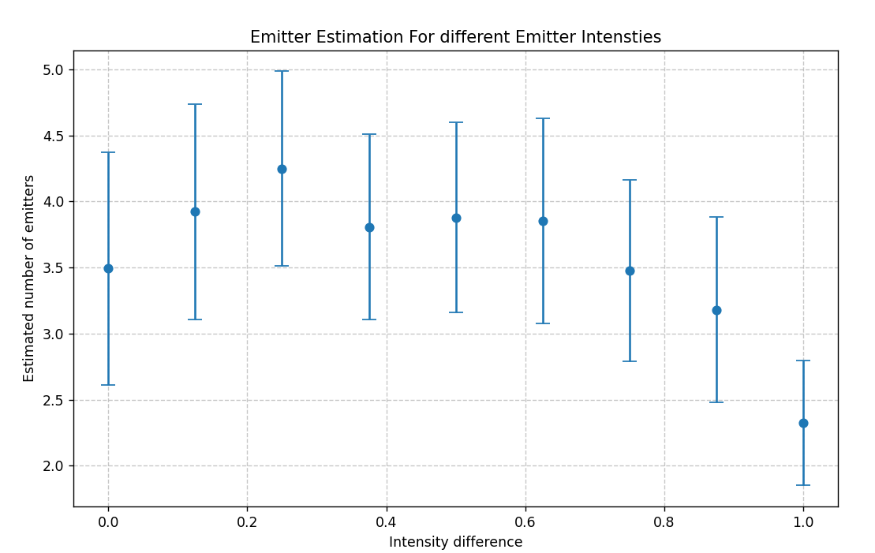
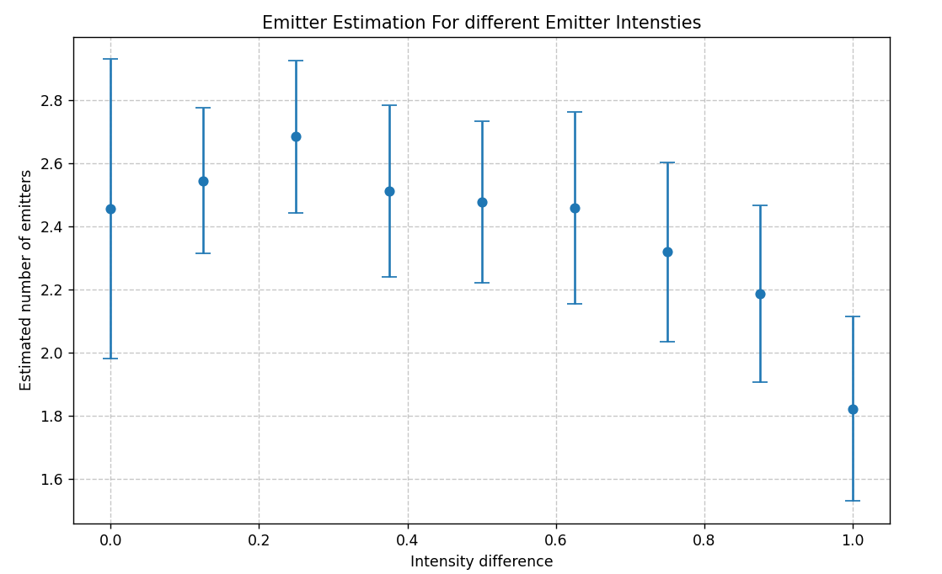
For 3 emitters, with third emitter varied intensity

Slide 6
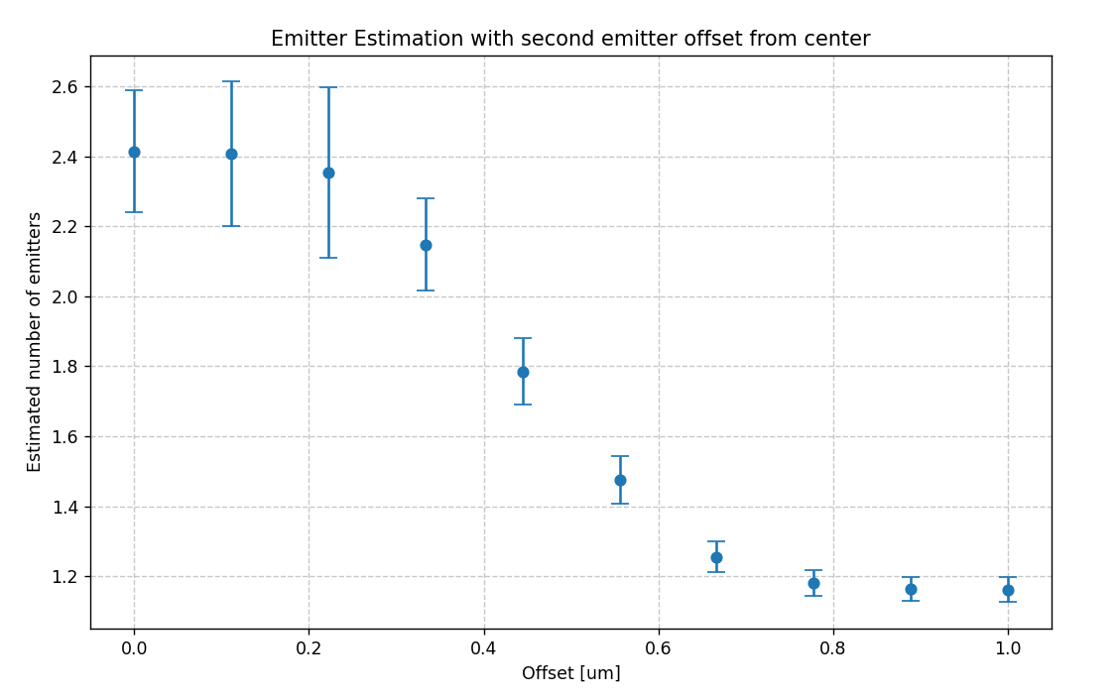
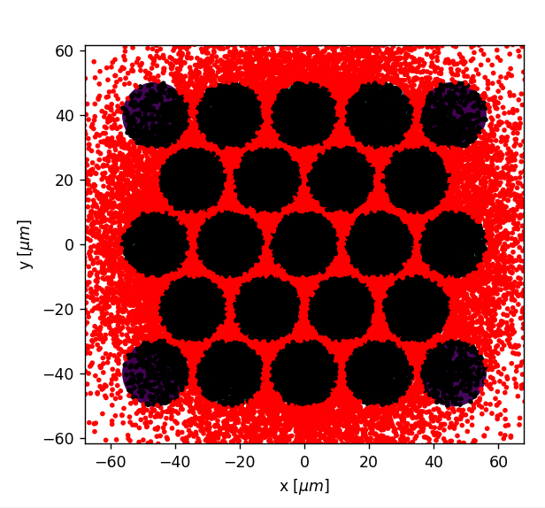
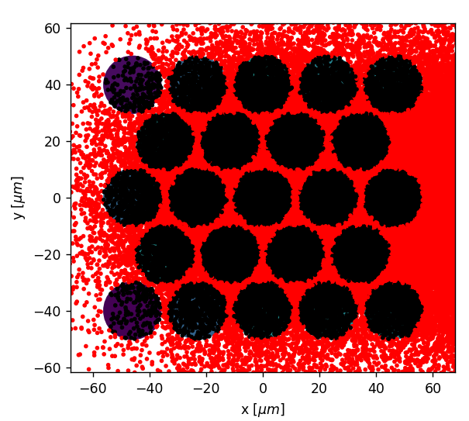
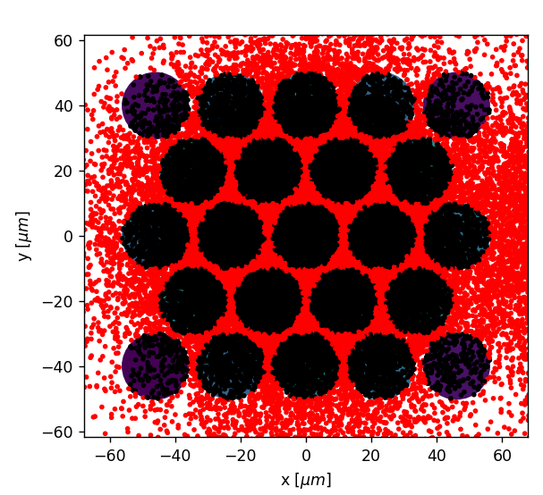
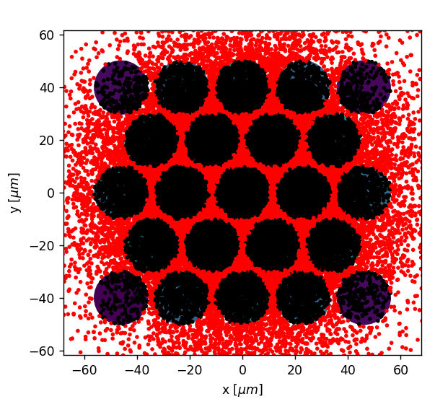
Second emitter shifting location (x-dir)
Magnification: 150x

Slide 7
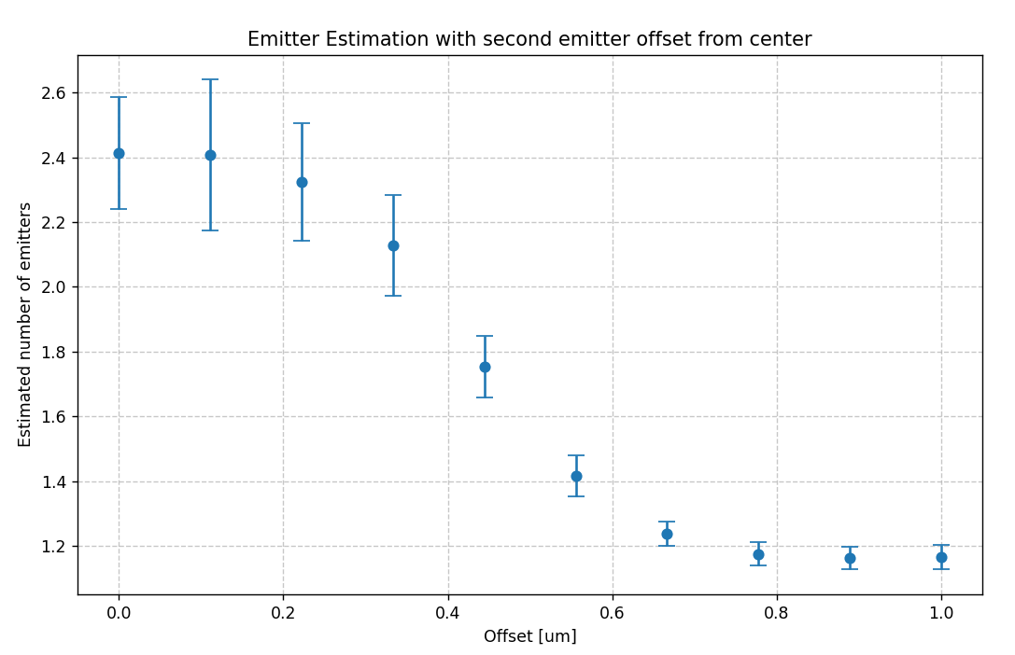
Second emitter shifting location (y-dir)
Very similar

Slide 8
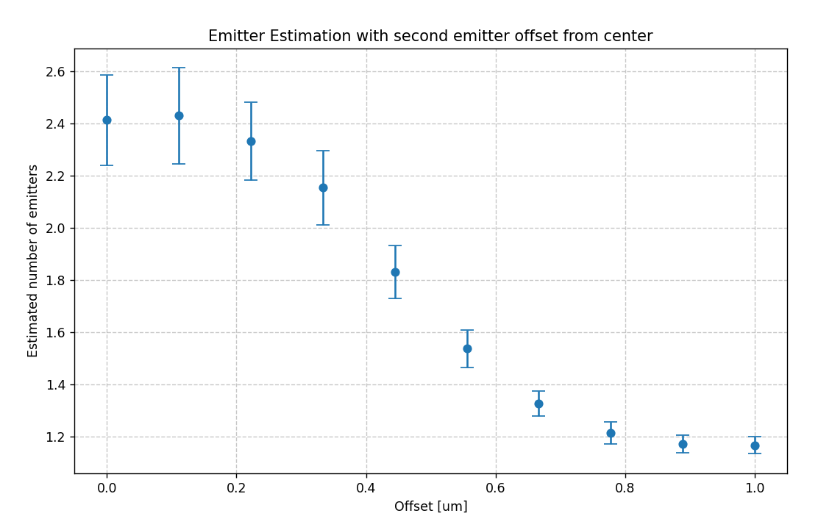
Second emitter shifting location (diagonal dir)

